Slide 1
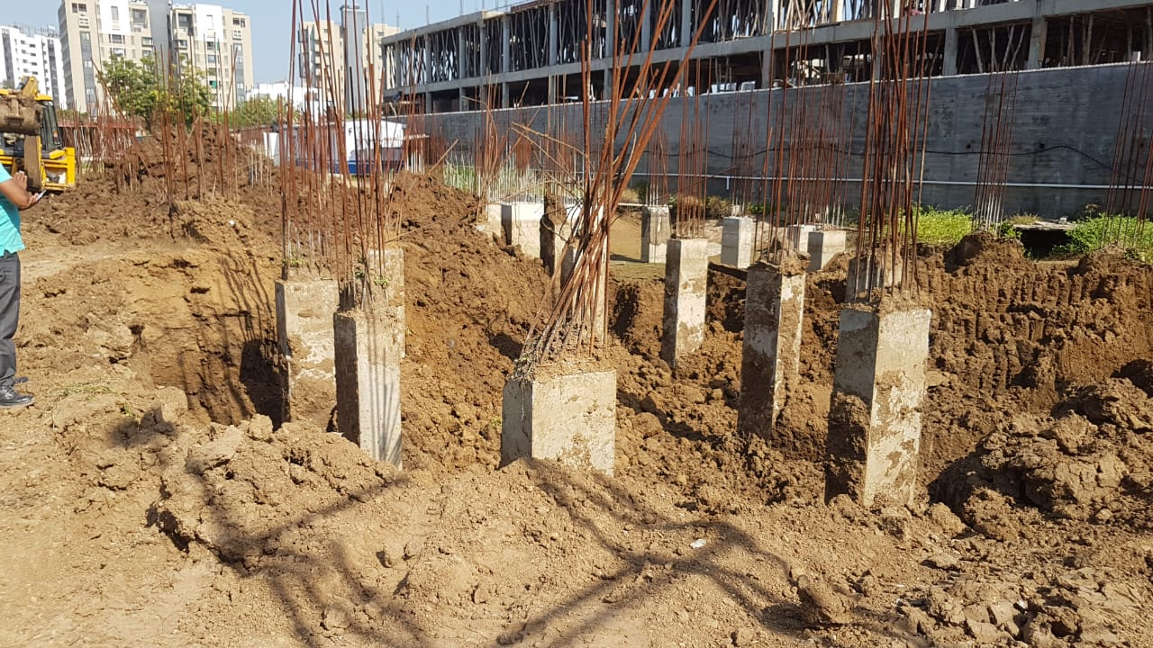
14-10-2019
Status
Tower-E Column Curing Up coming Task: Slab Casting will be on 17/10/2019

Slide 2
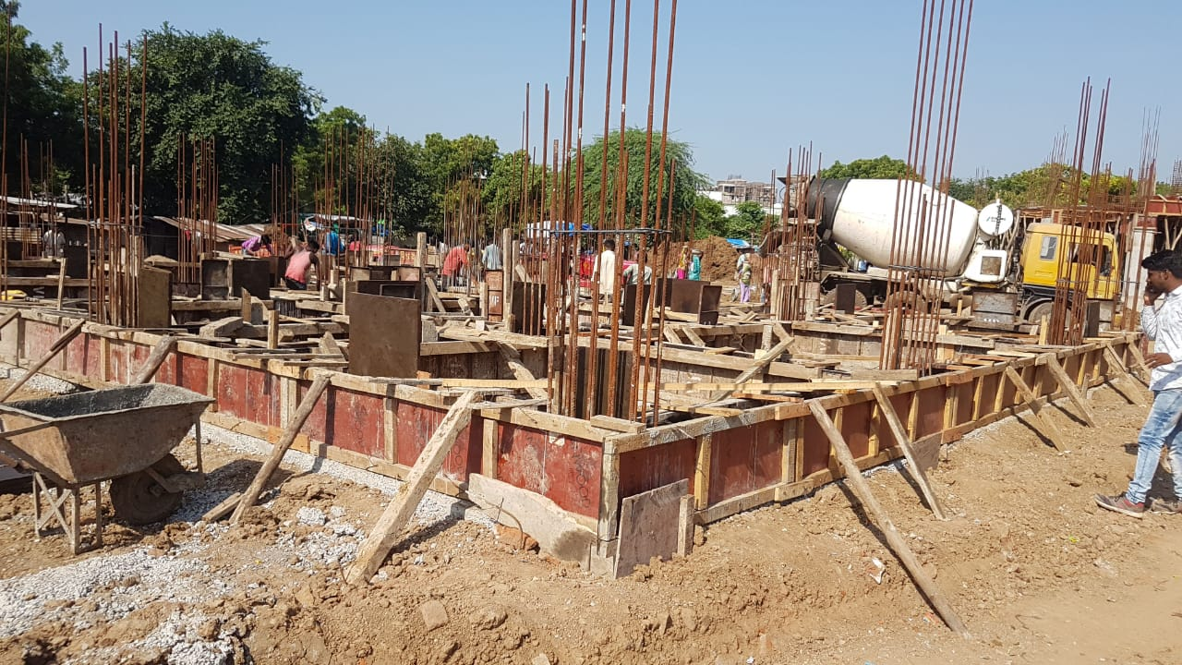
15-10-2019
Status
Tower-G Plinth Beam Up coming Task: Slab Casting will be on 17/10/2019

Slide 3
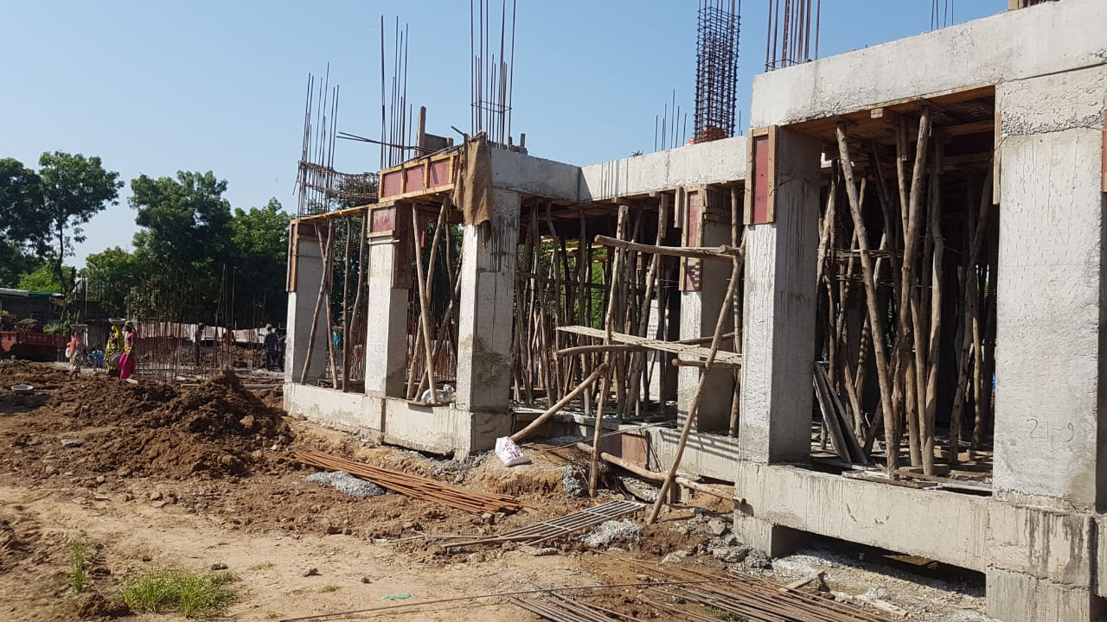
15-10-2019
Status
Tower-D Half slab casting done

Slide 4
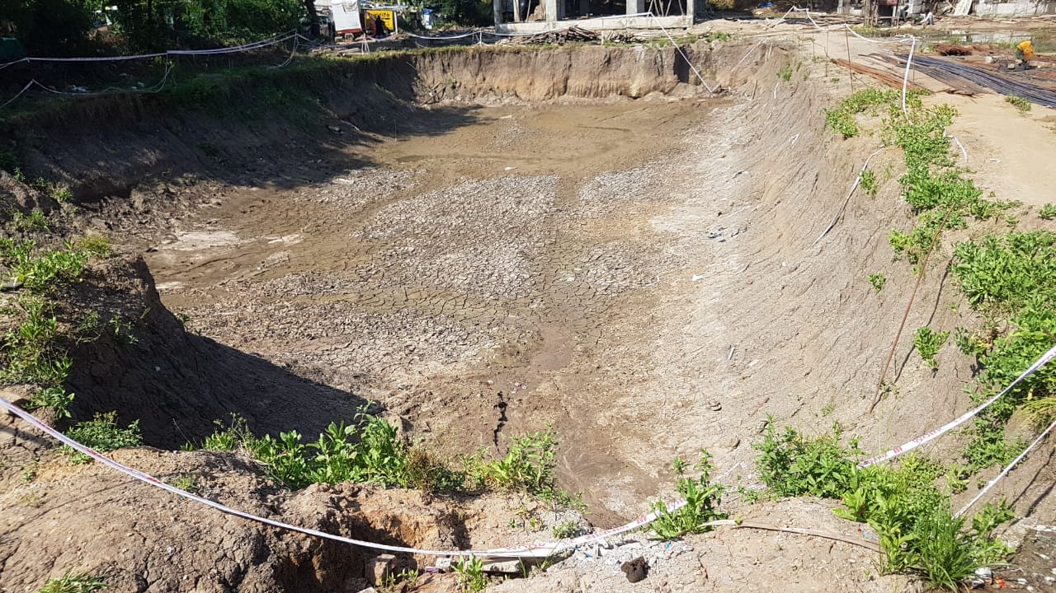
15-10-2019
Status
Tower-B Excavation done

Slide 5
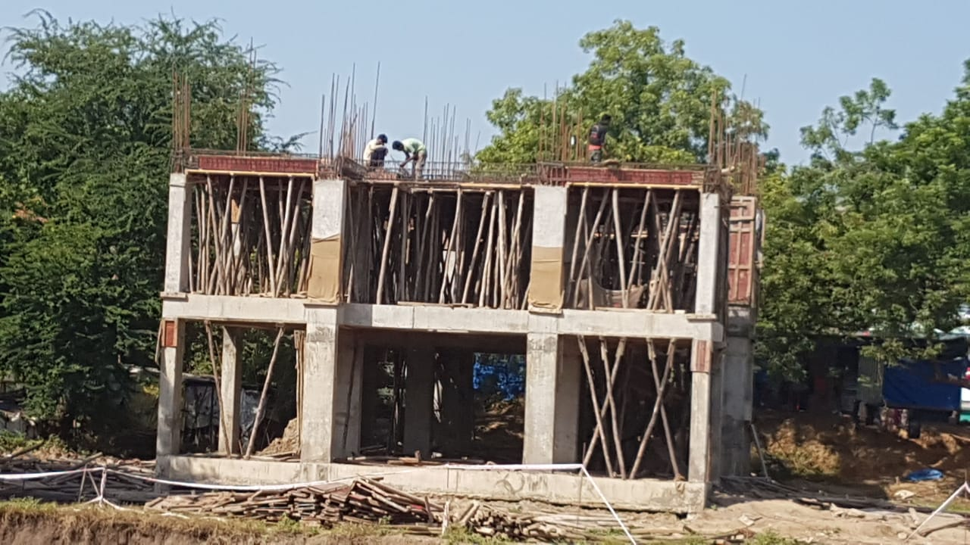
15-10-2019
Status
Tower-H Ground Floor slab casting done Up coming Task: First floor slab 18/10/2019

Slide 6
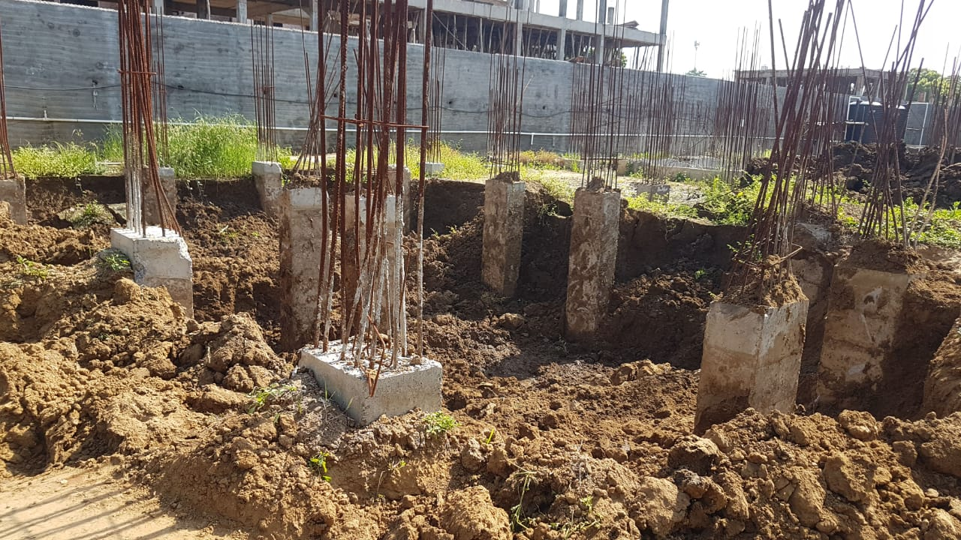
15-10-2019
Status
Tower-C Soil filling in progress Up coming Task: Plinth beam casting

Slide 7
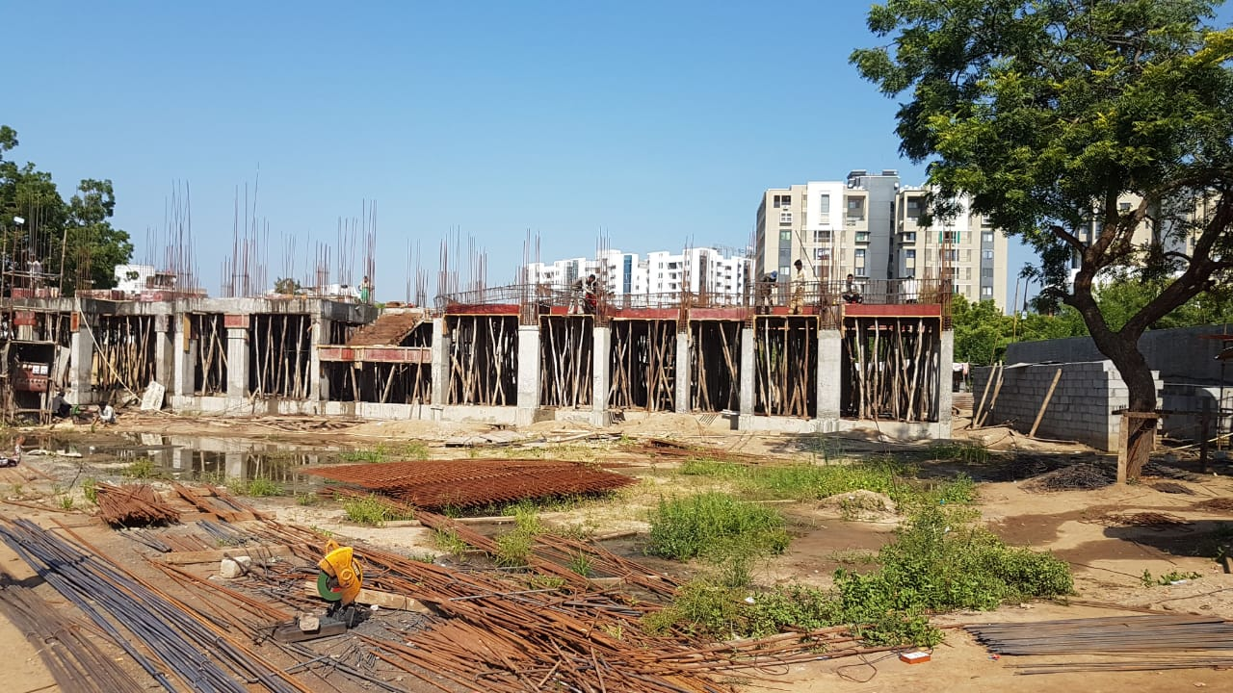
15-10-2019
Status
Tower-A Reinforcement done for GF Slab Up coming Task: Slab Casting will be on 17/10/2019

Slide 8
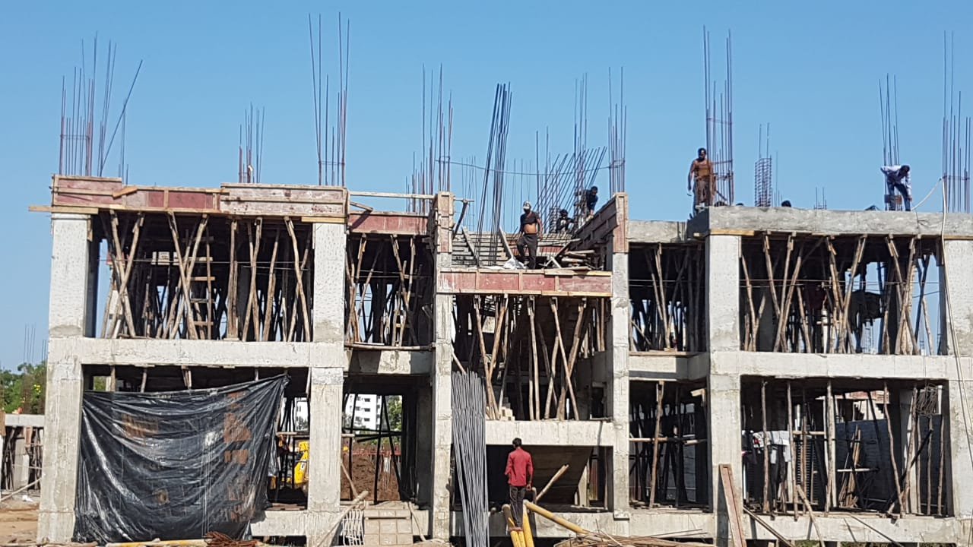
15-10-2019
Status
Tower-F First Floor slab casting done Up coming Task: SF column casting

